Slide 1




CONCLUSION
The Library management data Analysis System provides an efficient and Organized way to manage library operations and analyze library data. The system helps maintain book and member records, track book issues and returns, monitor overdue books, and manage fines with less manual effort.
Overall, the proposed system reduces paperwork, minimizes human errors, saves time, improves data management and provides useful insights for effective library administration.

Slide 2
CONCLUSION
The Library management data Analysis System provides an efficient and Organized way to manage library operations and analyze library data. The system helps maintain book and member records, track book issues and returns, monitor overdue books, and manage fines with less manual effort.
Overall, the proposed system reduces paperwork, minimizes human errors, saves time, improves data management and provides useful insights for effective library administration.

Slide 3
CONCLUSION
The Library management data Analysis System provides an efficient and Organized way to manage library operations and analyze library data. The system helps maintain book and member records, track book issues and returns, monitor overdue books, and manage fines with less manual effort.
Overall, the proposed system reduces paperwork, minimizes human errors, saves time, improves data management and provides useful insights for effective library administration.

Slide 4
CONCLUSION
The Library management data Analysis System provides an efficient and Organized way to manage library operations and analyze library data. The system helps maintain book and member records, track book issues and returns, monitor overdue books, and manage fines with less manual effort.
Overall, the proposed system reduces paperwork, minimizes human errors, saves time, improves data management and provides useful insights for effective library administration.

Slide 5
CONCLUSION
The Library management data Analysis System provides an efficient and Organized way to manage library operations and analyze library data. The system helps maintain book and member records, track book issues and returns, monitor overdue books, and manage fines with less manual effort.
Overall, the proposed system reduces paperwork, minimizes human errors, saves time, improves data management and provides useful insights for effective library administration.

Slide 6
CONCLUSION
The Library management data Analysis System provides an efficient and Organized way to manage library operations and analyze library data. The system helps maintain book and member records, track book issues and returns, monitor overdue books, and manage fines with less manual effort.
Overall, the proposed system reduces paperwork, minimizes human errors, saves time, improves data management and provides useful insights for effective library administration.

Slide 7
CONCLUSION
The Library management data Analysis System provides an efficient and Organized way to manage library operations and analyze library data. The system helps maintain book and member records, track book issues and returns, monitor overdue books, and manage fines with less manual effort.
Overall, the proposed system reduces paperwork, minimizes human errors, saves time, improves data management and provides useful insights for effective library administration.

Slide 8
CONCLUSION
The Library management data Analysis System provides an efficient and Organized way to manage library operations and analyze library data. The system helps maintain book and member records, track book issues and returns, monitor overdue books, and manage fines with less manual effort.
Overall, the proposed system reduces paperwork, minimizes human errors, saves time, improves data management and provides useful insights for effective library administration.

Slide 9
CONCLUSION
The Library management data Analysis System provides an efficient and Organized way to manage library operations and analyze library data. The system helps maintain book and member records, track book issues and returns, monitor overdue books, and manage fines with less manual effort.
Overall, the proposed system reduces paperwork, minimizes human errors, saves time, improves data management and provides useful insights for effective library administration.

Slide 10
CONCLUSION
The Library management data Analysis System provides an efficient and Organized way to manage library operations and analyze library data. The system helps maintain book and member records, track book issues and returns, monitor overdue books, and manage fines with less manual effort.
Overall, the proposed system reduces paperwork, minimizes human errors, saves time, improves data management and provides useful insights for effective library administration.

Slide 11

Data Analysis Essentials Cornerstone Project
First Review
Library Management Data Analysis System
Presented by
B.V.V.Satyanaaryana (26B21AI014)
G.D.Eswar Shanmukh(26B21AI034)
G. Sai Charan (26B21AI043)
S.T.N.V. Ganesh (26B21AI071)
Department of Artificial Intelligence & Machine Learning

Slide 12
Presentation Outline
Abstract
Introduction
Analysis
Requirements
Methodology
Expected output
Conclusion

Slide 13
ABSTRACT
The Library Management Data Analysis System is a software based application designed to efficiently manage and analyze library-related data. The system maintains information about books, members, books issuing, returns and fines in a centralized database. It reduces manual paperwork and makes it easier to search, update and manage library records. The system also provides data analysis features to identify useful patterns such as the most borrowed books, frequently active members, book availability, monthly borrowing trends and fine collection. These insights can help librarians understand library usage and make better decisions regarding book management and resource allocation. The system can be developed using technologies such as Python, Numpy, Pandas and Matplotlib.

Slide 14
INTRODUCTION
Libraries contain a large number of Books and member records.
Managing books, members, issues, returns manually can be difficult.
Before managing library resources, important details need to be analyzed such as:
Book details
Author
Category
Book Availability
Member Details
Issue and Return Dates
Fine Amount
Using Python Data Analysis, we can automatically clean, analyze and visualize the library data.

Slide 15
ANALYSIS
Existing System :
Th existing system mainly uses manual methods to manage library records.
Book details are maintained in registers or spreadsheets.
Member information is recorded manually.
Searching for a particular book or member can be time-consuming.
Book availability is difficult to track.
Manual data entry can lead to human errors.
Generating monthly or yearly reports requires additional manual work.
It is difficult to identify most borrowed books.

Slide 16
ANALYSIS
Limitations of Existing System:
Requires more manual work
Maintaining large amount of data is difficult
Searching records can be time-consuming
Book availability is not always easy to track
Higher possibility of human error
Fine calculation may be performed manually

Slide 17
ANALYSIS
Proposed System :
Develop a Library Management Data Analysis System using Python.
It Maintains all library information in a centralized database
It automatically tracks the book availability
It improves the accuracy and security of library data
It provides a search facility to quickly find books and members
It represents information using charts, graphs, dashboards

Slide 18
ANALYSIS
Advantages :
Reduces the manual work and paperwork
Provides faster searching and record management
Improves the data accuracy
Generates reports quickly
Saves time
Improves library efficiency
Easy book tracking

Slide 19
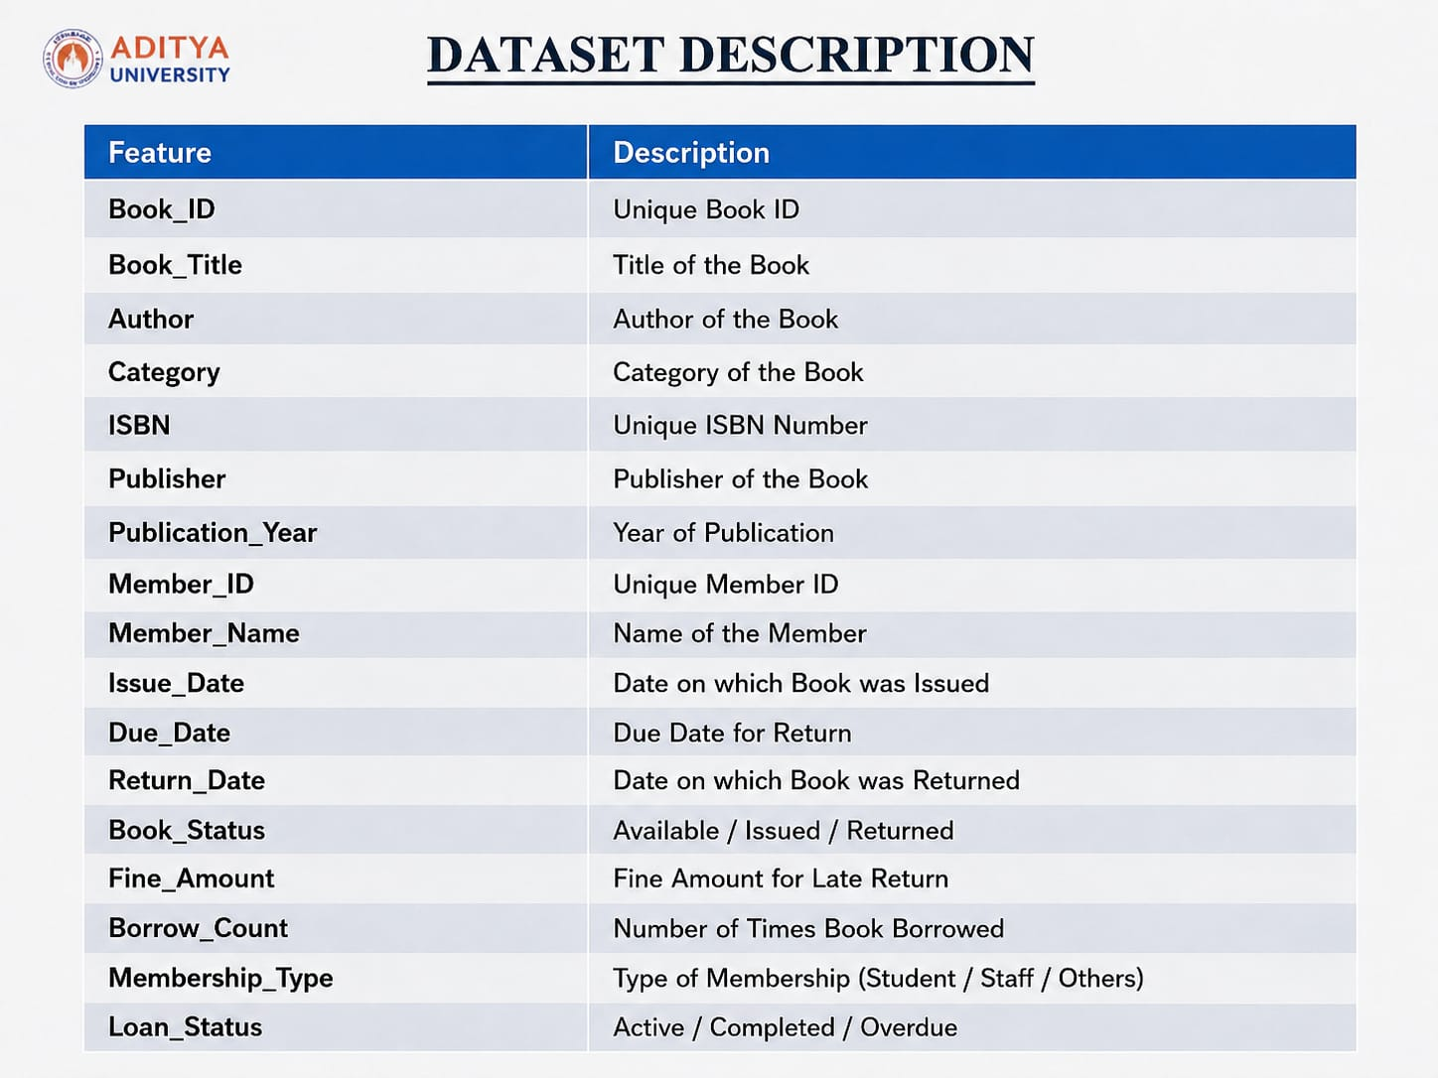
ANALYSIS

Slide 20
REQUIREMENTS
Hardware Requirements
Processor: Intel Core i3 or above
RAM: Minimum 4 GB
Storage: 10 GB free space
Input Devices: Keyboard, Mouse
Output Device: Monitor, Printers
Software Requirements
Operating System: Windows 10/11, Linux
Programming Language: python
IDE: Google Collab/ Jupyter Notebook/ Visual Studio Code
Libraries: Pandas, Numpy, Matplotlib

Slide 21
METHODOLOGY
Modules:
Module 1
Dataset Loading
Import libraries
Read CSV Files
Load library dataset
Display first rows
Module 2
Data Exploration
Dataset Shape
Column names
Data types
Missing values
Statistical Summary
Check duplicate records
Module 3
Data Cleaning
Handle missing values
Remove duplicates
Correct inconsistent data
Handle incorrect values

Slide 22
METHODOLOGY
Module 4
Data Preprocessing
Convert data types
Encode categorical data
Feature selection
Date formatting
Prepare data for analysis
Module 5
Exploratory Data Analysis
Visualize library data
Book availability
Book category Distribution
Most borrowed books
Active members
Monthly borrowing trends
Fine analysis
Module 6
Library Data Analysis
Analyze borrowing patterns
Identify popular books
Identify popular categories
Analyze member activity

Slide 23
METHODOLOGY
Module 7
Data Visualization & Reports
Bar charts
Pie charts
Line graphs
Tables
Generate summary reports
Displays important library insights
Module 8
Result & Decision Making
Interpret analysis results
Identify library usage patterns
Improves book management
Supports better library decisions

Slide 24
Overview :
The Library Management Data Analysis System id designed to analyze library data and provide useful information about books, members, borrowing, and fines. The project uses Python and data analysis techniques to process the library dataset.
The system first loads and examines the dataset, then cleans and prepares the data for analysis. It analyzes important information such as book availability, most borrowed books, popular categories, active members, borrowing trends, overdue books, and fine amounts.

Slide 25
EXPECTED OUTPUTS
Library dashboard
Book availability report
Active Member report
Book issue report
Book return report
Fine report
Most borrowed books chart
Charts and Graphs

Slide 26
CONCLUSION
The Library management data Analysis System provides an efficient and Organized way to manage library operations and analyze library data. The system helps maintain book and member records, track book issues and returns, monitor overdue books, and manage fines with less manual effort.
Overall, the proposed system reduces paperwork, minimizes human errors, saves time, improves data management and provides useful insights for effective library administration.

Slide 27
THANK YOU

